Slide 1
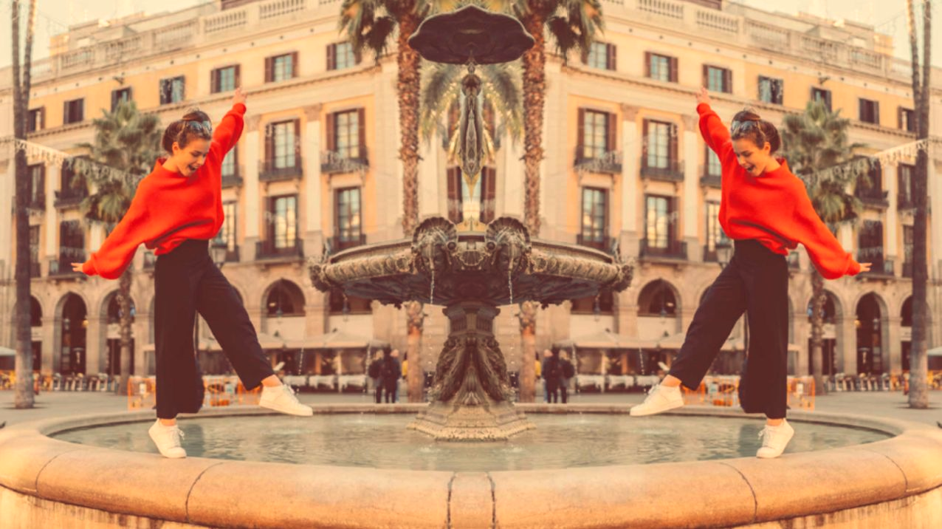
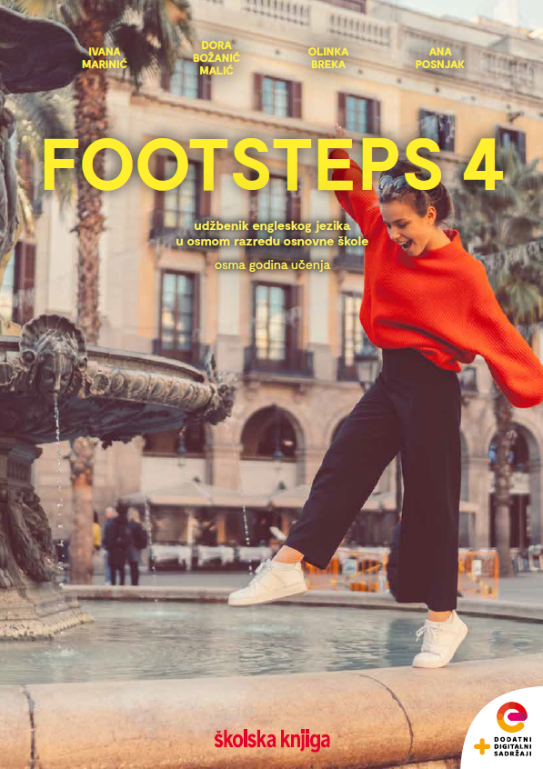

UNIT 3;
Trends
Lesson 3; Bummer

Slide 2
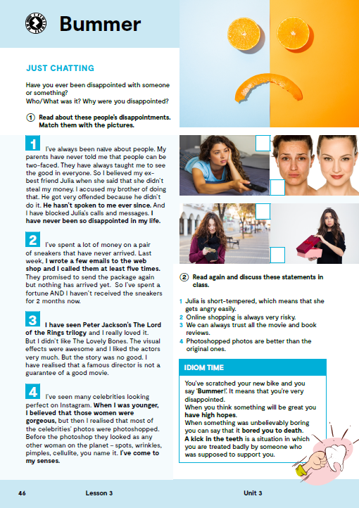
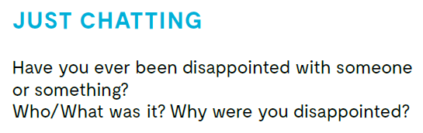
Have you ever been disappointed with someone or something? Who/What was it?
Why were you disappointed?
Do you know the meaning of these expressions?
disappointment
web shop
package
photoshop
director
to be two-faced
a guarantee
wrinkles
spots
pimples
to be short-tempered
razočaranje
web trgovina
paket
photoshop
direktor
biti dvoličan
garancija
bore
točkice
prištići
biti eksplozivan / kratkog fitilja

Slide 3

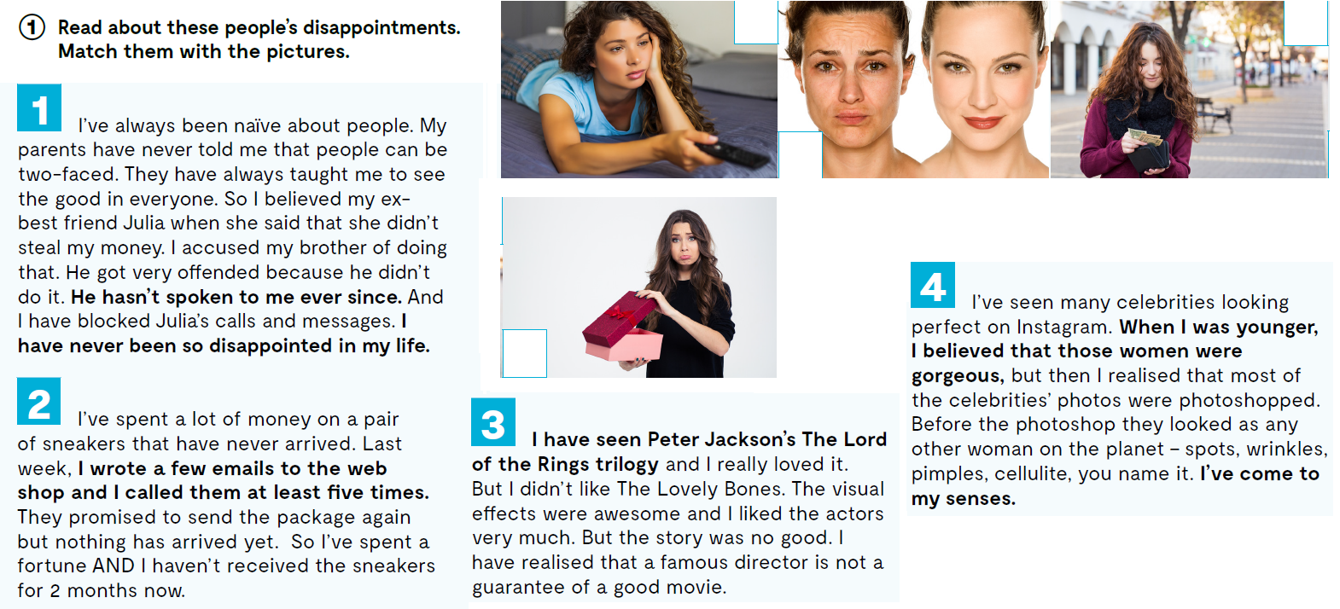
Read about these people’s disappointments.
Match them with the pictures. Why are they disappointed?
3
1
4
2

Slide 4
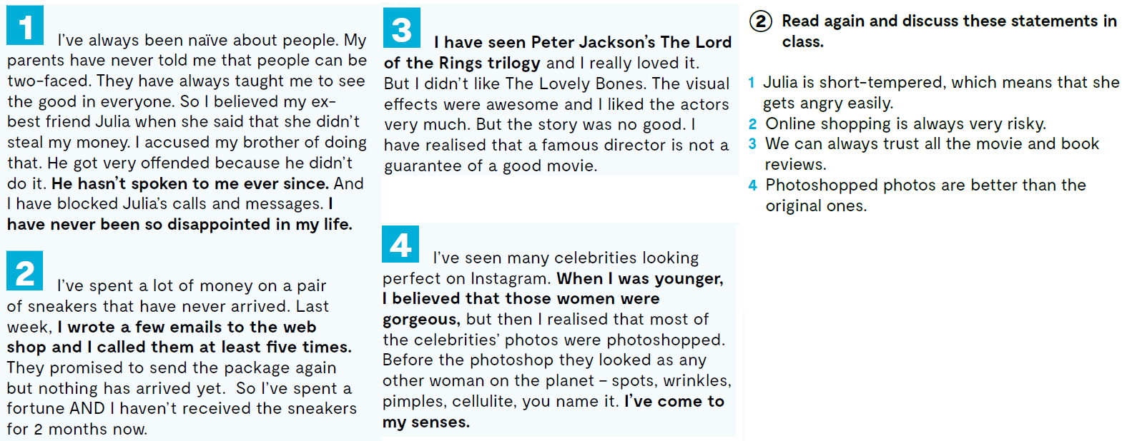
Read again and think about these statements.

Slide 5

Open the following link and then click on LEARN MORE!
https://www.e-sfera.hr/dodatni-digitalni-sadrzaji/bcb8bb28-549a-44d9-abbb-e19b774d2fa3/
How to deal with disappointment?
“Not meeting expectations” is how Merriam-Webster dictionary describes things or events that disappoint us. We have all felt it at some point in our lives.
Perhaps we did not get a gift we wanted, our friend was late for a film we wanted to see together, or the ice-cream we got was disgusting.
Sometimes, disappointments can be even more serious. So, what can we do about it? Here are some steps that help us deal with disappointment in a healthy way.
.
Do the tasks.

Slide 6
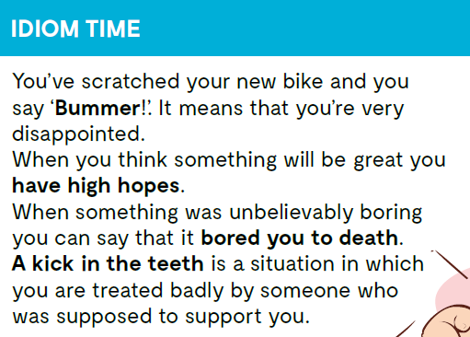
It was a real bummer being ill on holiday.
I have high hopes of passing the exam.
She was alone all day and bored to death.
She was dismissed from her job, which was a real kick in the teeth after all the work she'd done.

Slide 7
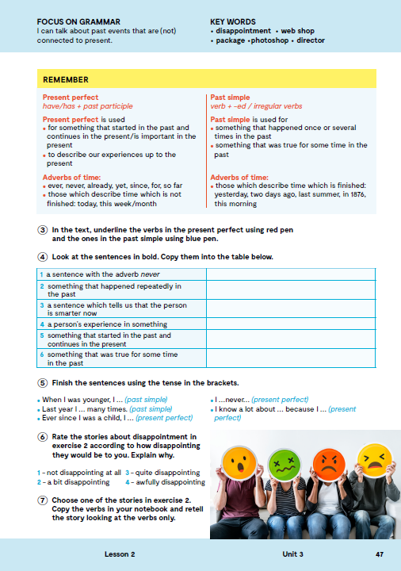
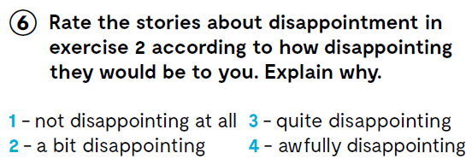
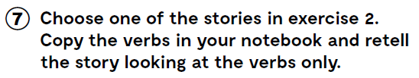

Slide 8

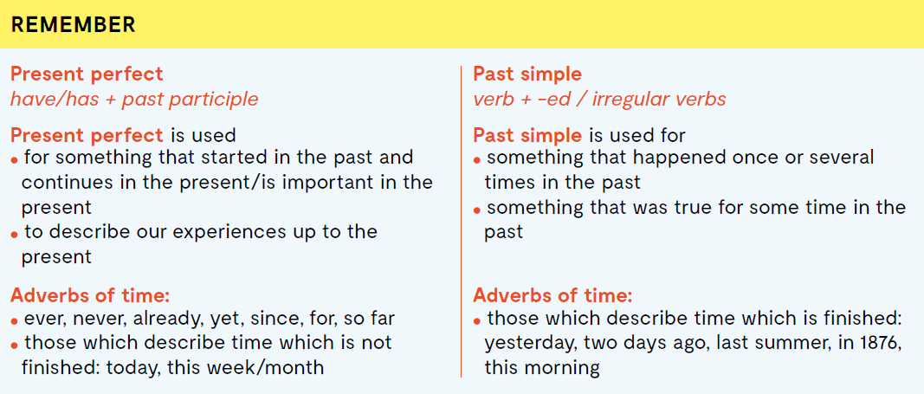

Slide 9
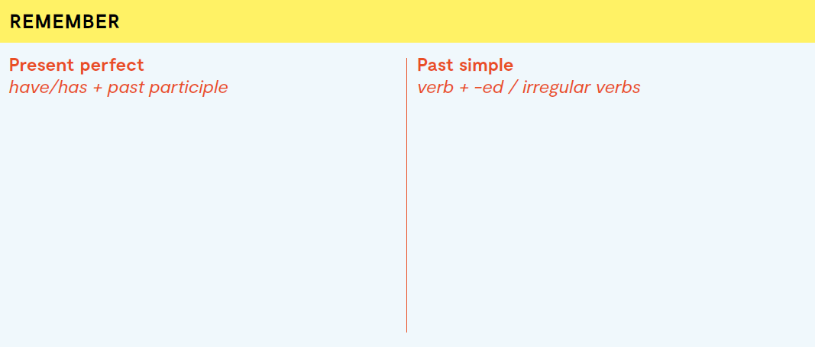
HAVE / HAS (u 3. osobi jednine) + past participle (Pravilni glagoli: glagol + d/ed;
Nepravilni glagoli: 3. stupac popisa nepravilnih glagola)
Present perfect koristimo:
za izricanje radnje koja je započela u prošlosti i nastavlja se i u sadašnjosti ili je važna za sadašnjost
za opisivanje dosadašnjih iskustava
Priloške oznake vremena:
- ever, never, already, yet, since, for, so far
- priloške oznake vremena koje opisuju vrijeme koje nije završeno: today, this week/month
glagol + d/ed; Nepravilni glagoli:
2. stupac popisa nepravilnih glagola)
Past Simple koristimo:
za izricanje radnje koja se dogodila jednom ili više puta u prošlosti
za opisivanje nečega što je bilo istina u jednom vremenu u prošlosti
Priloške oznake vremena:
- priloške oznake vremena koje opisuju vrijeme koje je završilo: yesterday, two days ago, last summer, in 1876, this morning

Slide 10
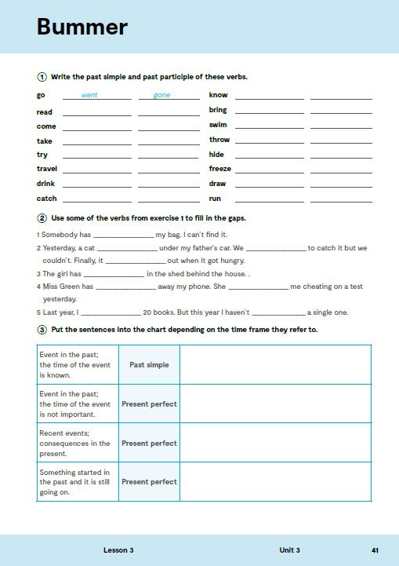
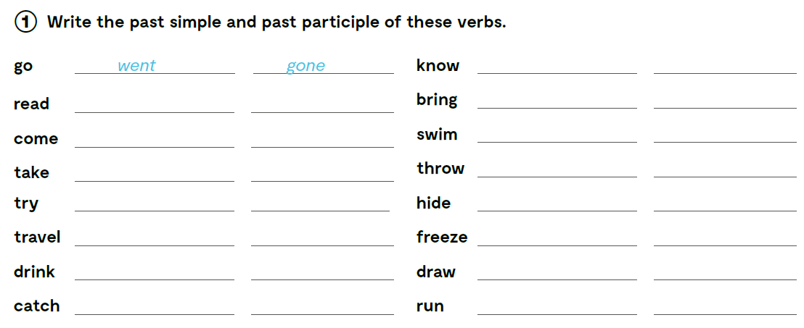
knew
known
read
read
brought
brought
came
come
swam
swum
took
taken
threw
thrown
tried
tried
hid
hidden
travelled
travelled
froze
frozen
drank
drunk
drew
drawn
caught
caught
ran
run

Slide 11
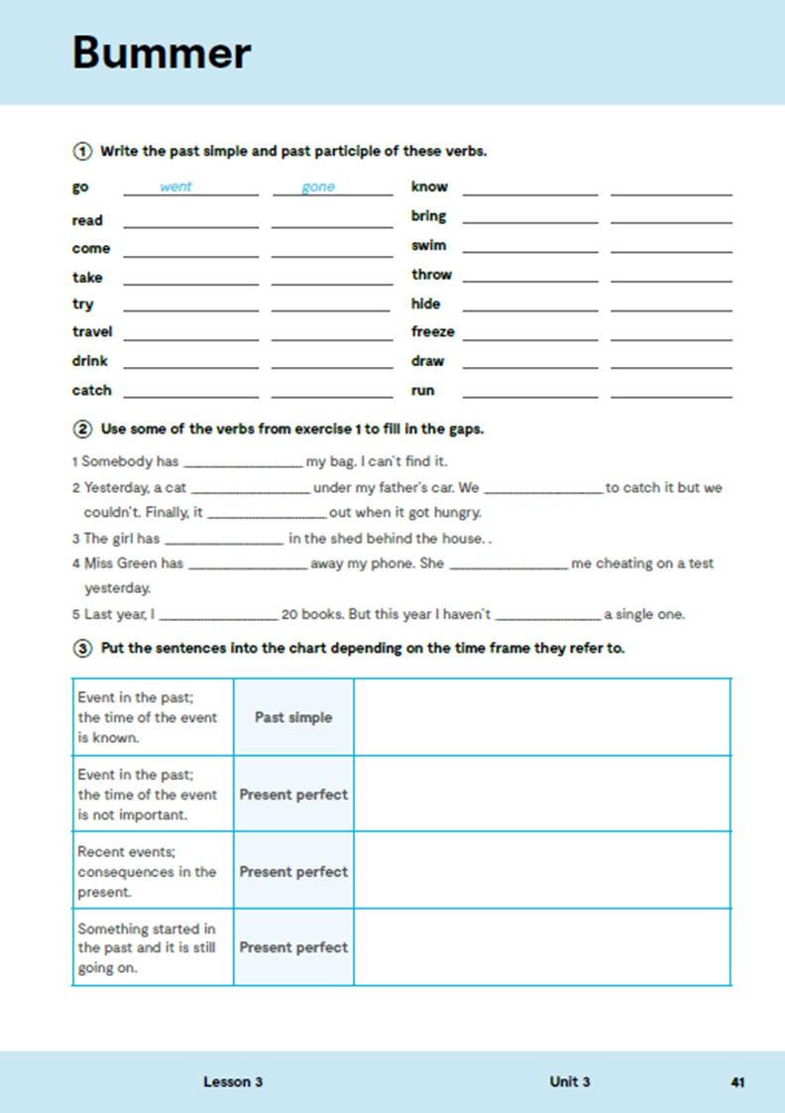
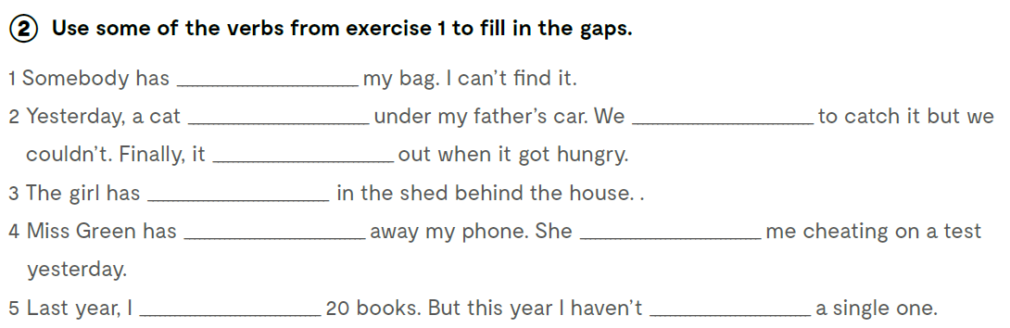
Use some of the verbs from exercise 1 to fill in the gaps.
taken
hit
tried
came
hidden
taken
caught
read
read

Slide 12
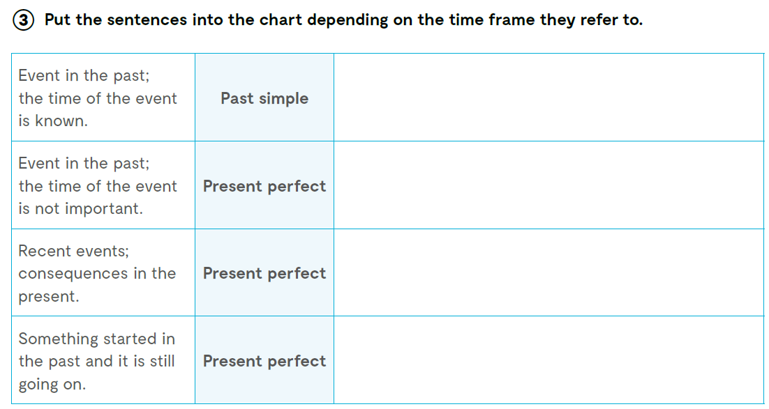
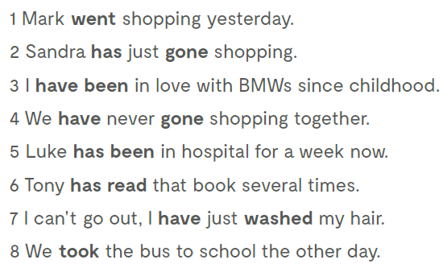
Mark went shopping yesterday.
We took the bus to school the other day.
We have never gone shopping together.
Tony has read that book several times
Sandra has just gone shopping.
I can’t go out, I have just washed my hair.
I have been in love with BMWs since childhood.
Luke has been in hospital for a week now.

Slide 13
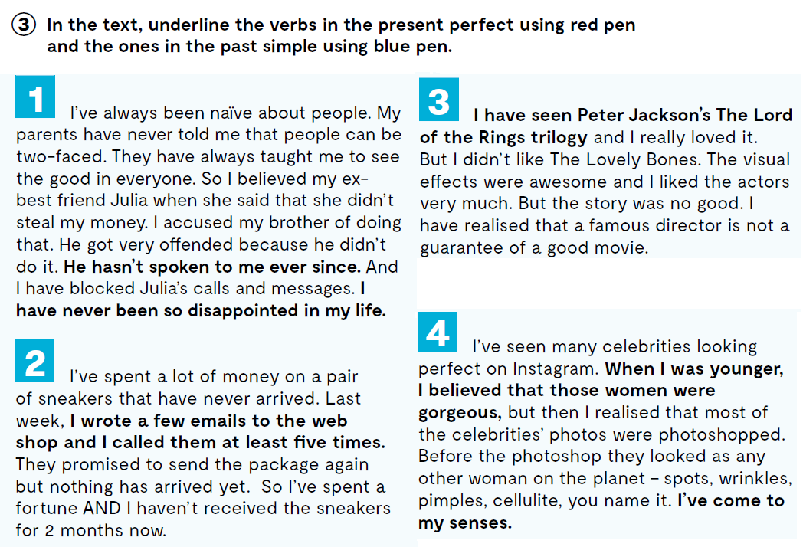


Slide 14
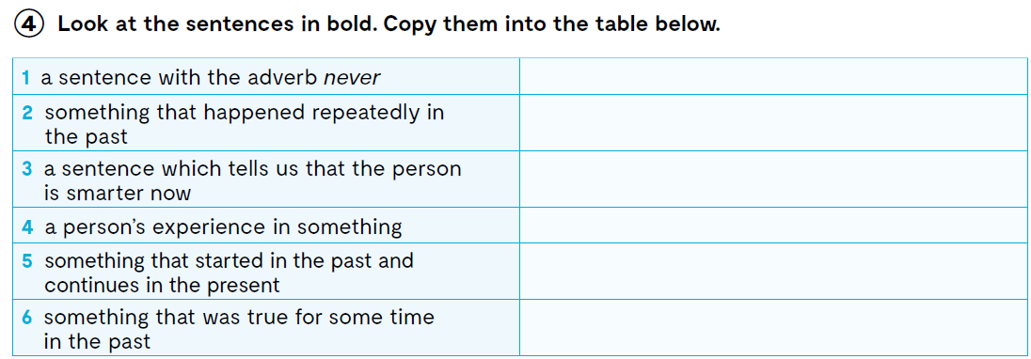
I have never been so disappointed in my life.
I wrote a few emails to the web shop and I called them at least five times.
I’ve come to my senses.
I have seen Peter Jackson’s The Lord of the Rings trilogy and I really loved it.
He hasn’t spoken to me ever since.
When I was younger, I believed that those women were gorgeous…

Slide 15
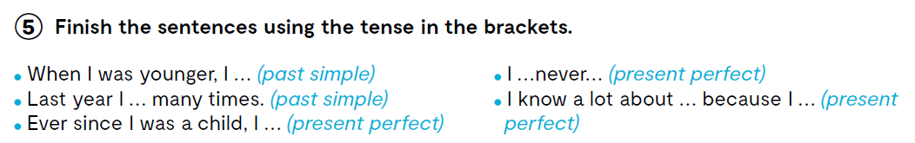
When I was yonger I played with toys.

Slide 16
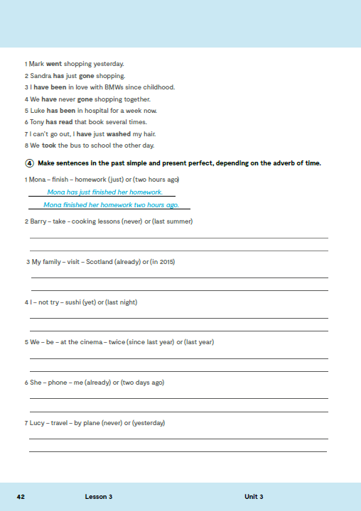
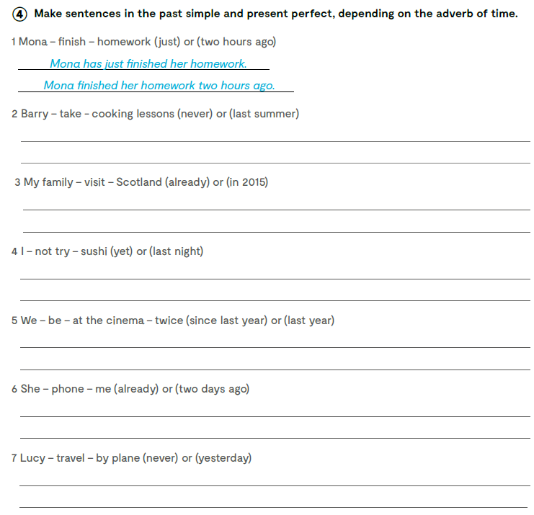
Barry has never taken cooking lessons.
Barry took cooking lessons last summer.
My family has already visited Scotland.
My family visited Scotland in 2015.
I haven’t tried sushui yet.
I didn’t try sushi last night.
We have been at the cinema twice since last year..
We were at the cinema twice last year.
She has already phoned me.
She phoned me two days ago.
Lucy has never travelled by plane.
Lucy travelled by plane yesterday.

Slide 17
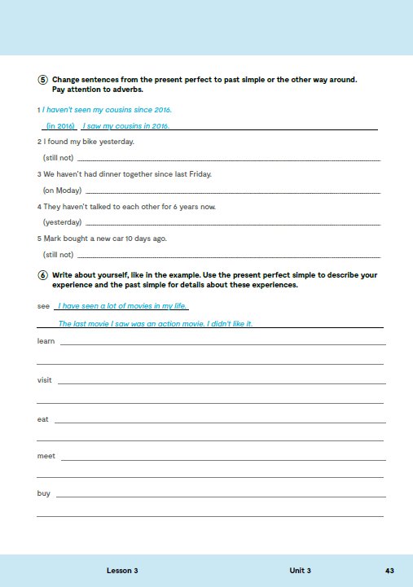
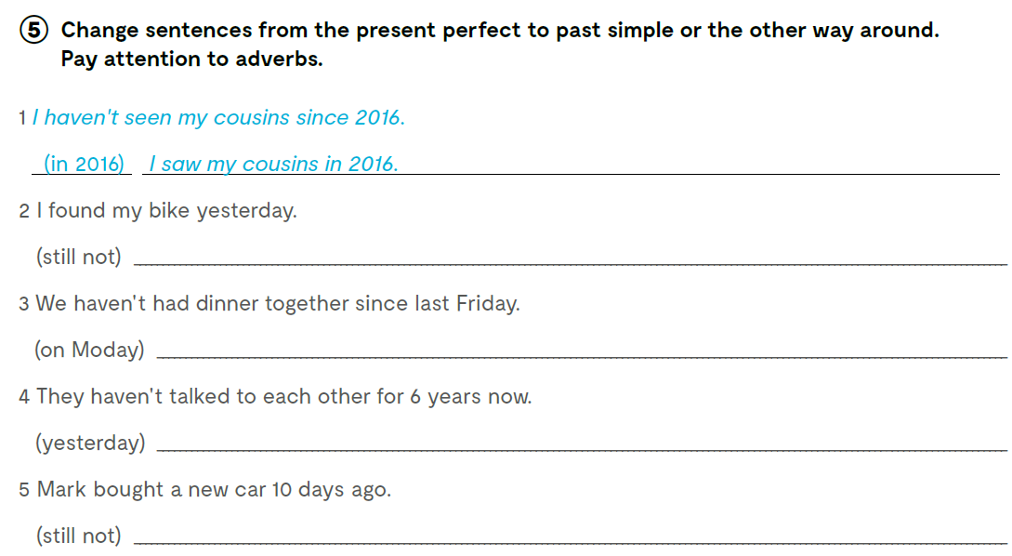
I still haven’t found my bike.
We din’t have dinner together on Monday.
They didn’t talk to each other yesterday.
Mark still hasn’t bought a new car.
Check what you have learnt. https://learningapps.org/watch?v=pyi3jt61v21
https://wordwall.net/resource/24561133

Slide 18
